Slide 1

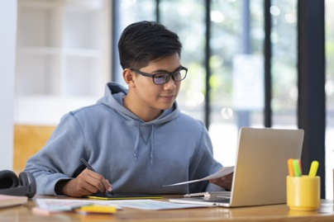
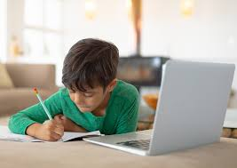

English & ICT Classes
Gr 6 to 11
hemmathagama
palliporuwa
For both Tamil & English medium students. ON GOING……
Don’t miss it……..
Theory revision to do the paper.
Past papers & model papers discussion.
Tips to score marks in writing.
Explanation in English and Tamil for better understanding.
Past model paper & discussions with tips and simple
techniques to score marks.
For Registration
071 0344549
S. Kalaiselvan.
Skillful trainer in teaching.
*Conditions Apply

